Slide 1
Housing Price Prediction
Names
Ben Liu

Slide 2
Background
Why do we care?
Kun He

Slide 3
Solutions
Regression
Classification
Data processing
Feature selection
Models:
Linear regression
Multilayer perceptron
Pros: intuitive and easy
Cons: Not much to change
Data processing
Discretize the price
Models:
Random forest
SVM
Pros: ensemble
Cons: discretization error

Slide 4
Data Processing
Clean data and etc
Tianxiao Zhang

Slide 5
Regression
Time series
Heatmap
…
Guojun Xiong, Kun He

Slide 6

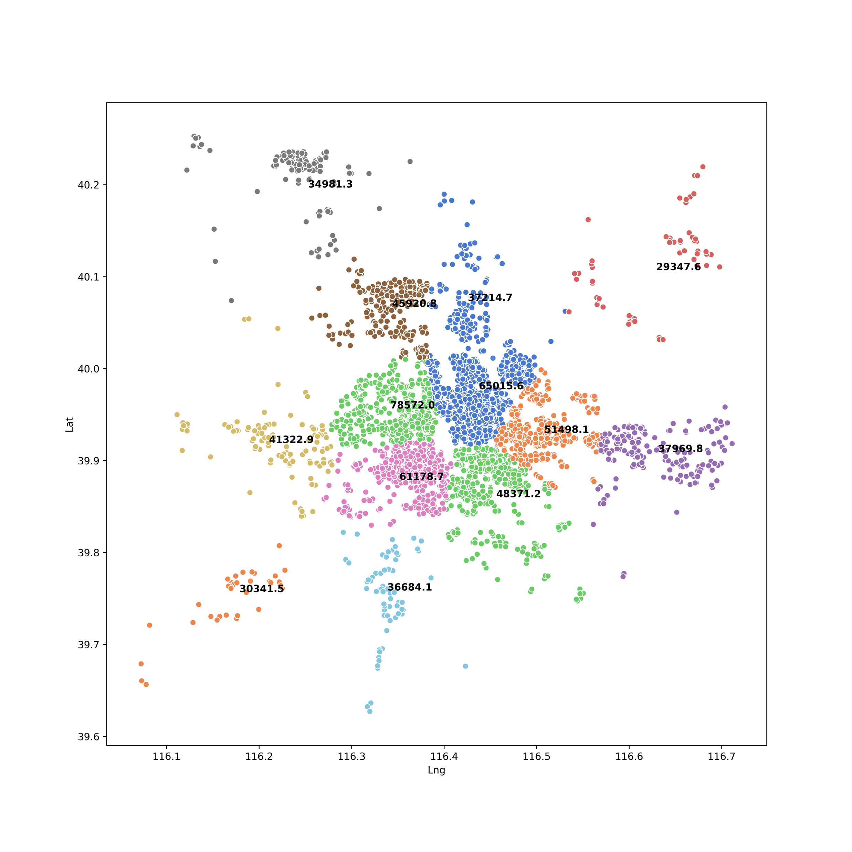
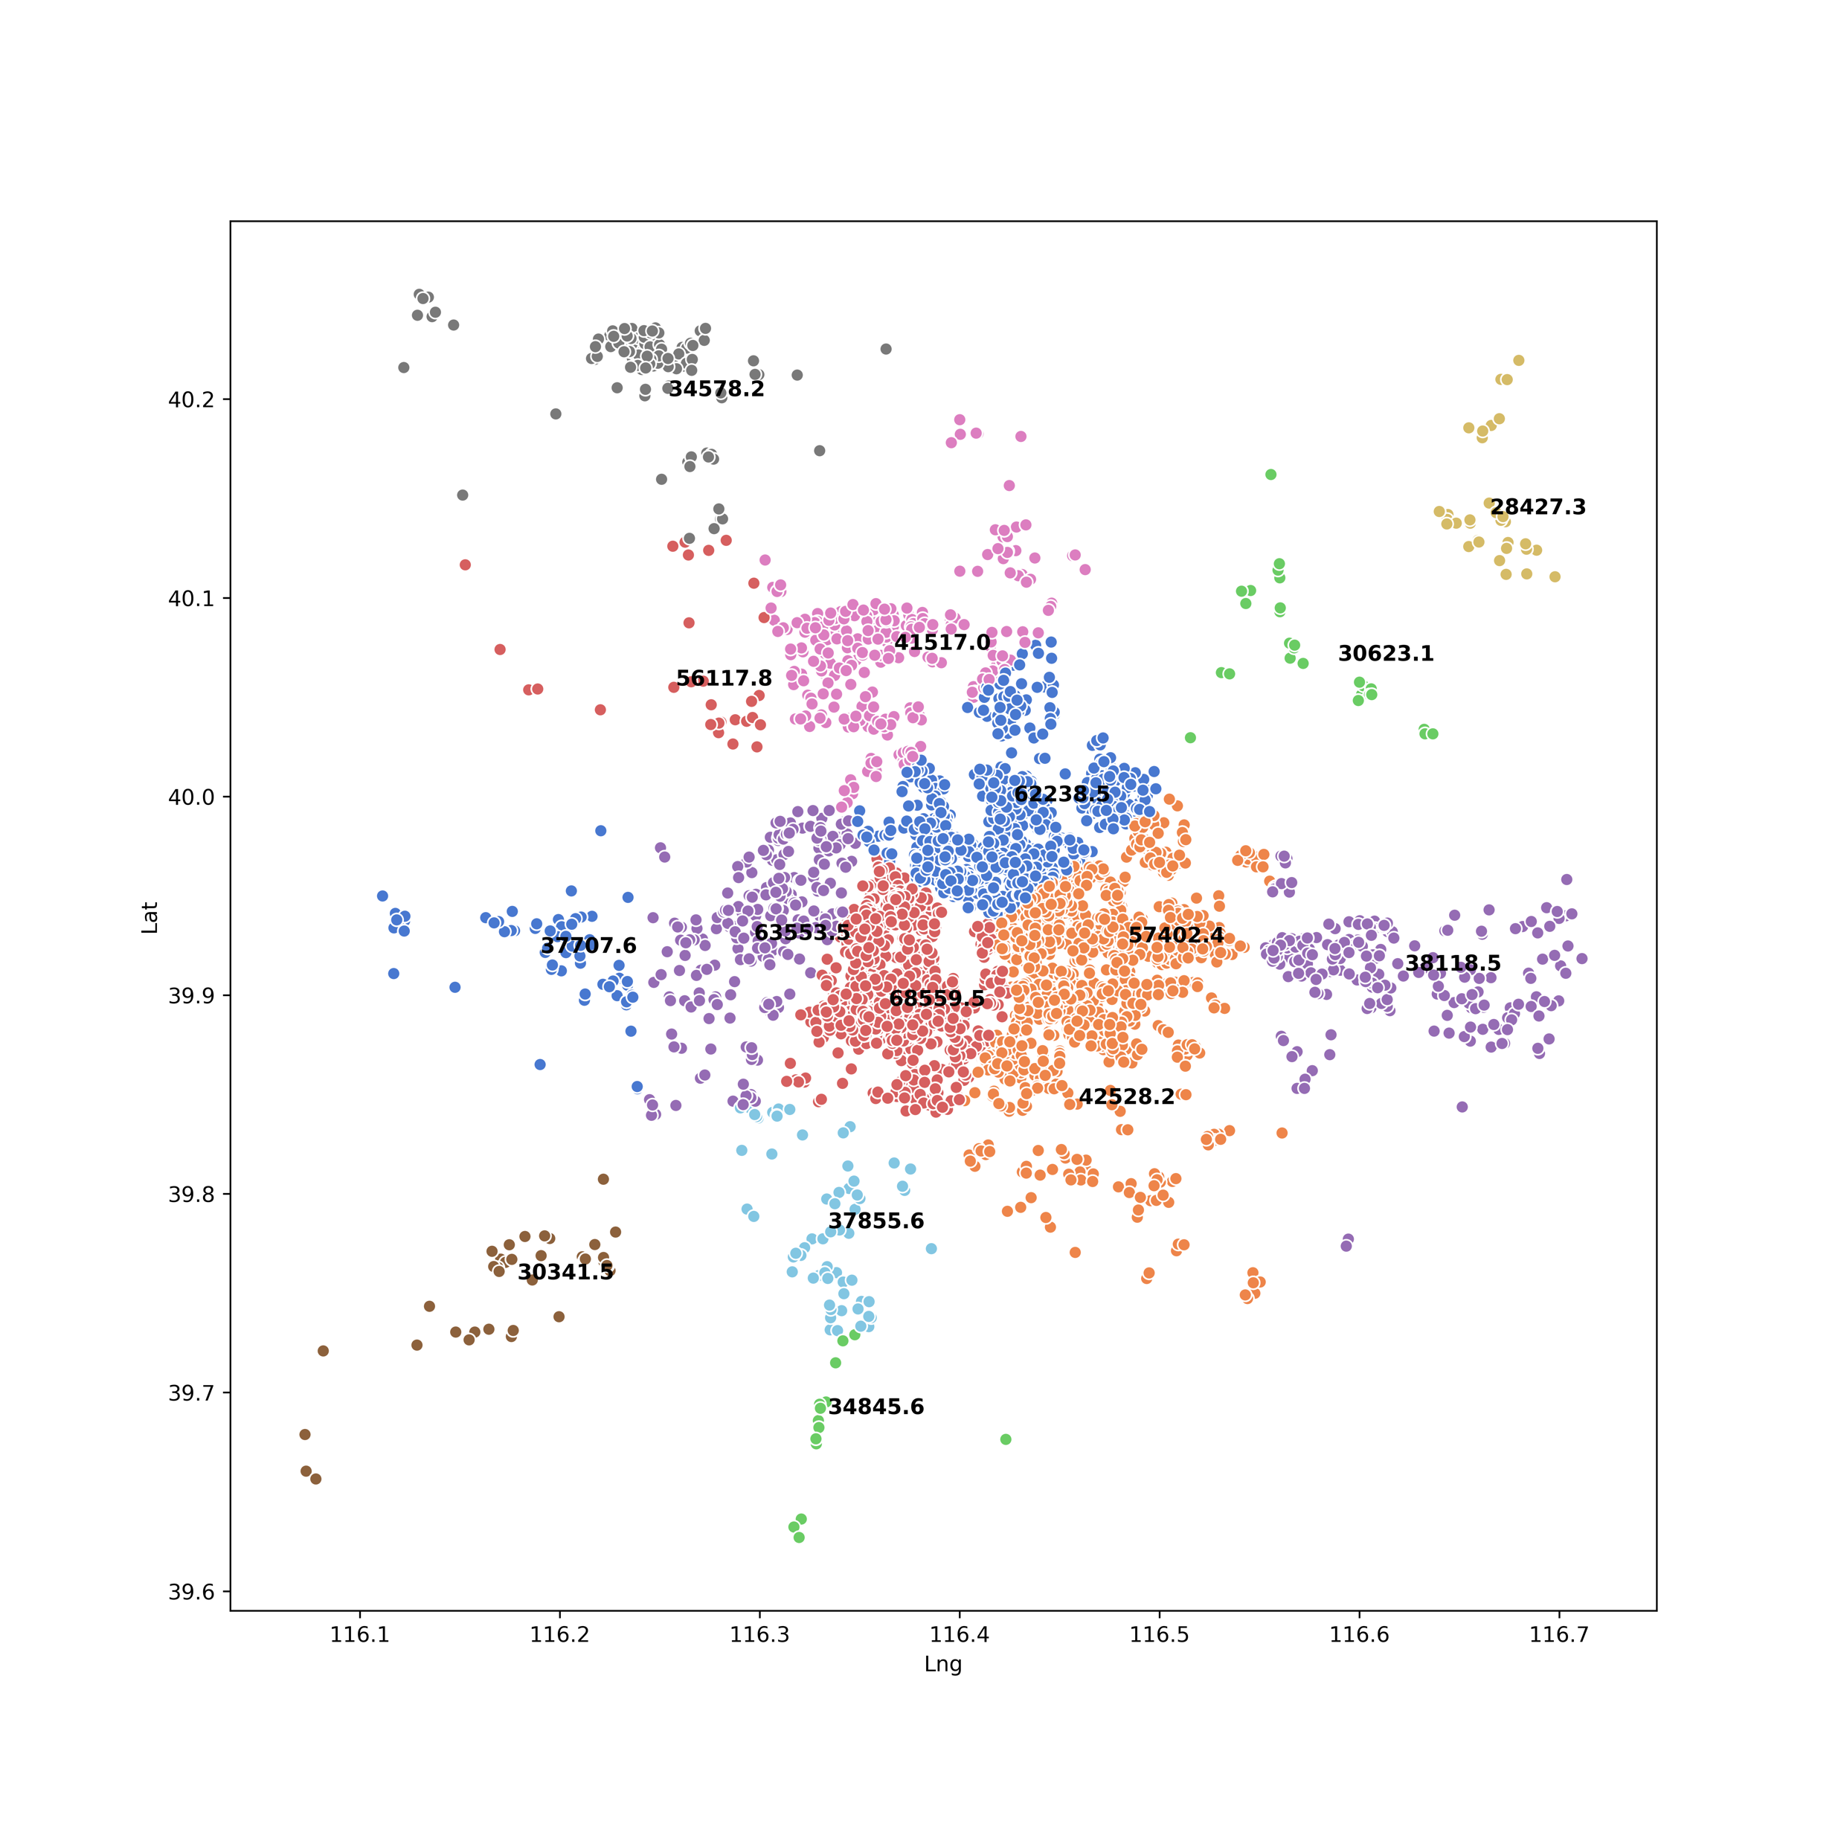
Clustering by Geographic Info
K-Means (K=13) Birch

Slide 7
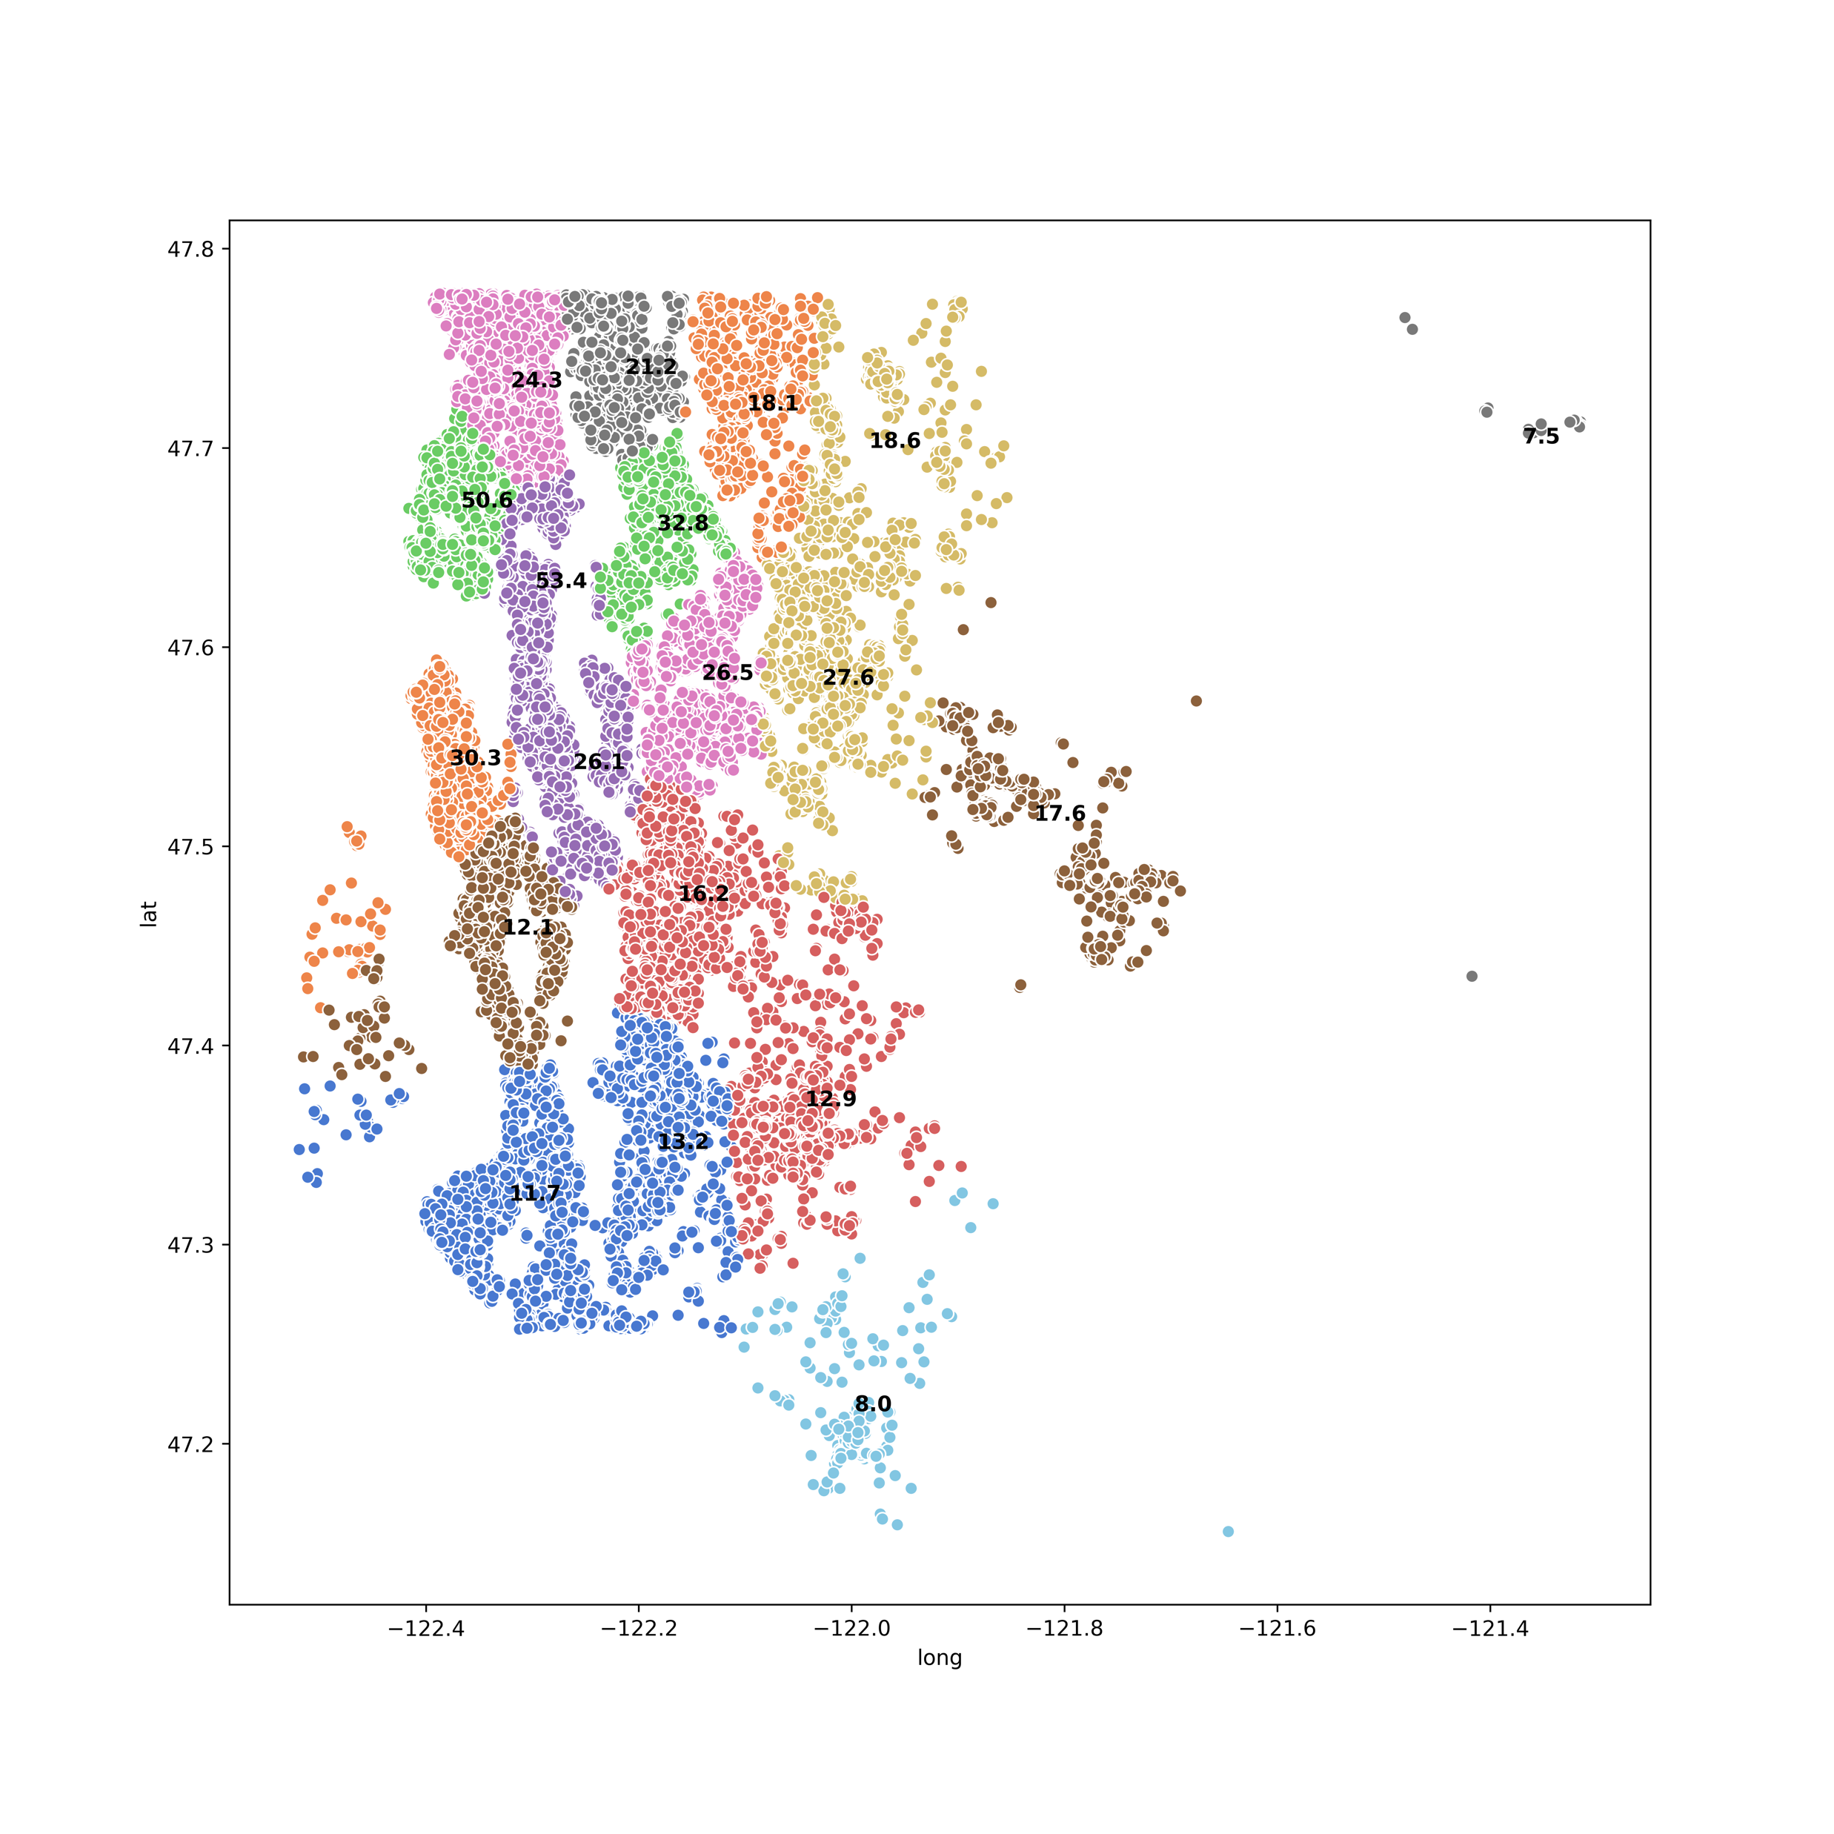
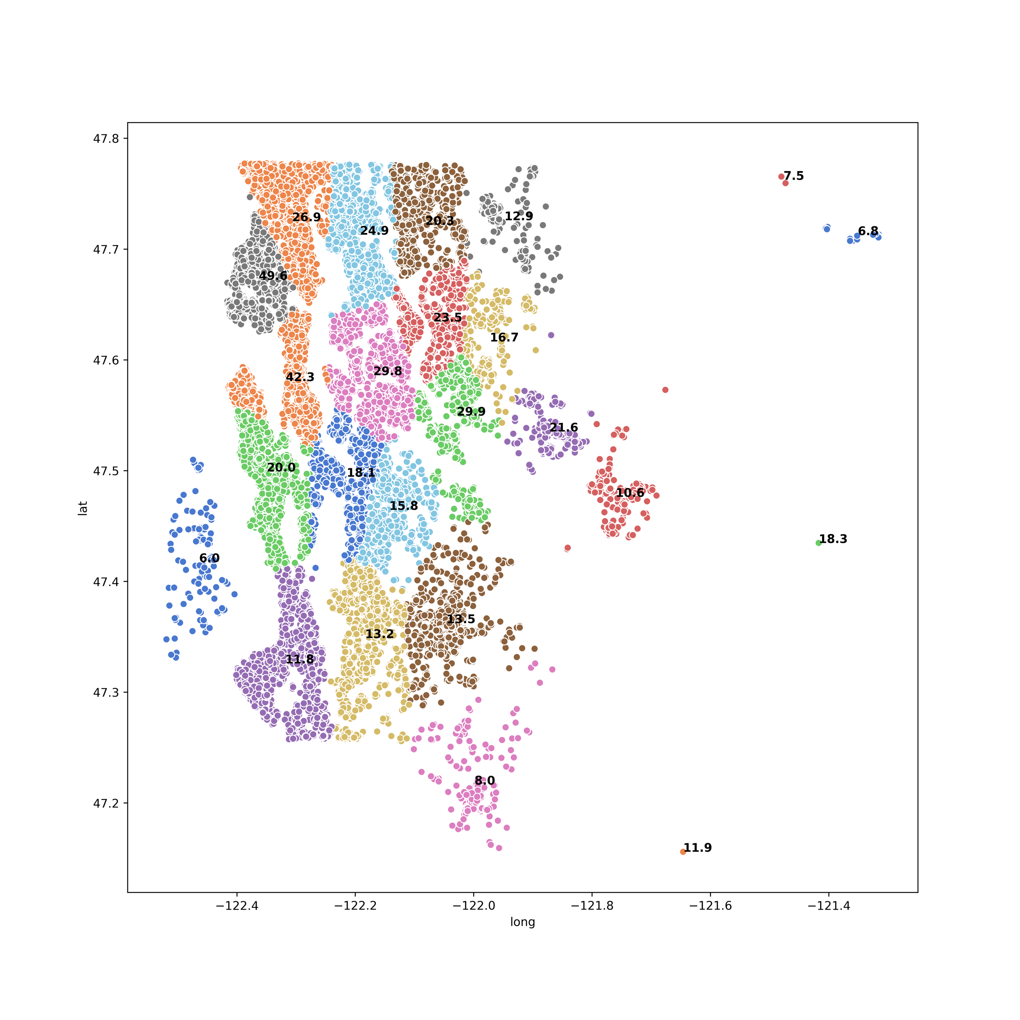
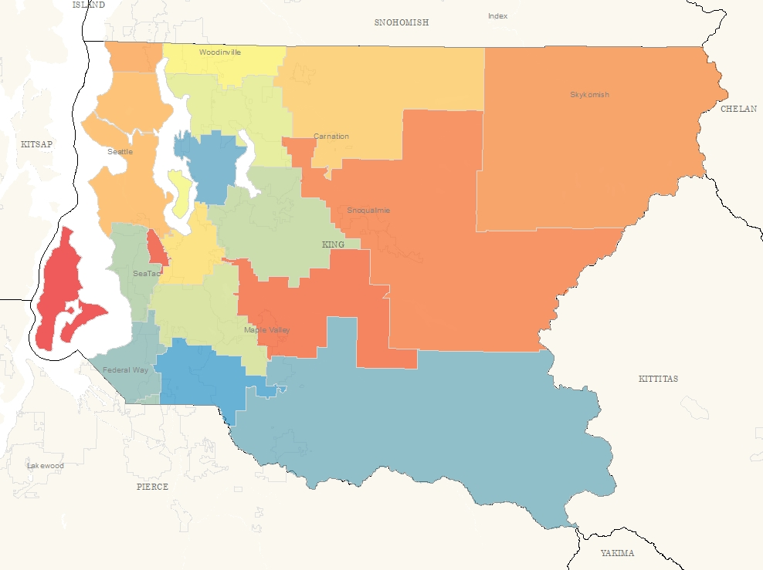
Clustering by Geographic Info
K-Means (K=19) Birch

Slide 8
Classification
Easiest case: clustering by geographic info

Slide 9
Classification
Discretization
…
Xien Hong, Xiaohan Zhang

